Slide 1


Slide 2

eProject Management System

Slide 3
eProject Team
Final Year Project
Presented by:
Ahsan Ashraf
Mohtasim Shahbaz
Muhammad Umar
Supervisor:
Ma’am Shaina Ashraf

Slide 4
Outline
Why eProject Management System?
Introduction
Stakeholders
Technicalities
Future Work

Slide 5
eProject Management System
Why eProject Management System?

Slide 6
Why eProject Management System?
Barriers of communication between supervisor and students.
Students mostly face the problem of meeting the supervisor, timeline and deadline.
Project evaluation is manual.

Slide 7
Why eProject Management System?
Students usually don’t have ideas for project.
Data is not centralized.
It’s difficult to synchronize.

Slide 8
eProject Management System
Introduction

Slide 9

Introduction
Our Project is need of the COMSATS University because currently manual system is being used.
Our application is for the final year projects management committee, students & faculty in COMSATS University.

Slide 10
Introduction
To full fill the needs of student of Final Year Project, in our application students will get updates about their projects through our portal.
In our project students are allowed to submit the proposal online.

Slide 11
Introduction
Supervisor will see the online working and the timeline of Final year project.
The eProject Management System will facilitate fyp-committee members for proposal, fyp-report 1, and fyp-report 2 submissions online.

Slide 12
Introduction
Evaluator will be able to evaluate assigned project online and also submit their feedback via our system.

Slide 13
eProject Management System
Objective

Slide 14
Objective
To create an automated system that follows complete final year project’s lifecycle and maintains repository of all projects.
It manages notifications and due dates.

Slide 15
Objective
It will keep updated student and supervisor and it will also allow examiner to review and evaluate projects.

Slide 16
eProject Management System
Stakeholders

Slide 17
Stakeholders
FYP committee Head
FYP committee Members
Supervisors
Students

Slide 18
FYP committee Head
Login
Register user
Manage Homepage
Register Project
Set deadlines
Set notifications
Change Password
logout

Slide 19
FYP COMMITTEE MEMBERS
Login
Project list
Assign evaluators
Change project status
Change password
Logout

Slide 20
Supervisor
Login
Add new ideas
Assign task
Projects
Add marks
Change password
Logout

Slide 21
STUDENT
Login
Search ideas
Upload task assigned task
View grades
See notifications
Change password
logout

Slide 22
eProject Management System
Technicalities

Slide 23
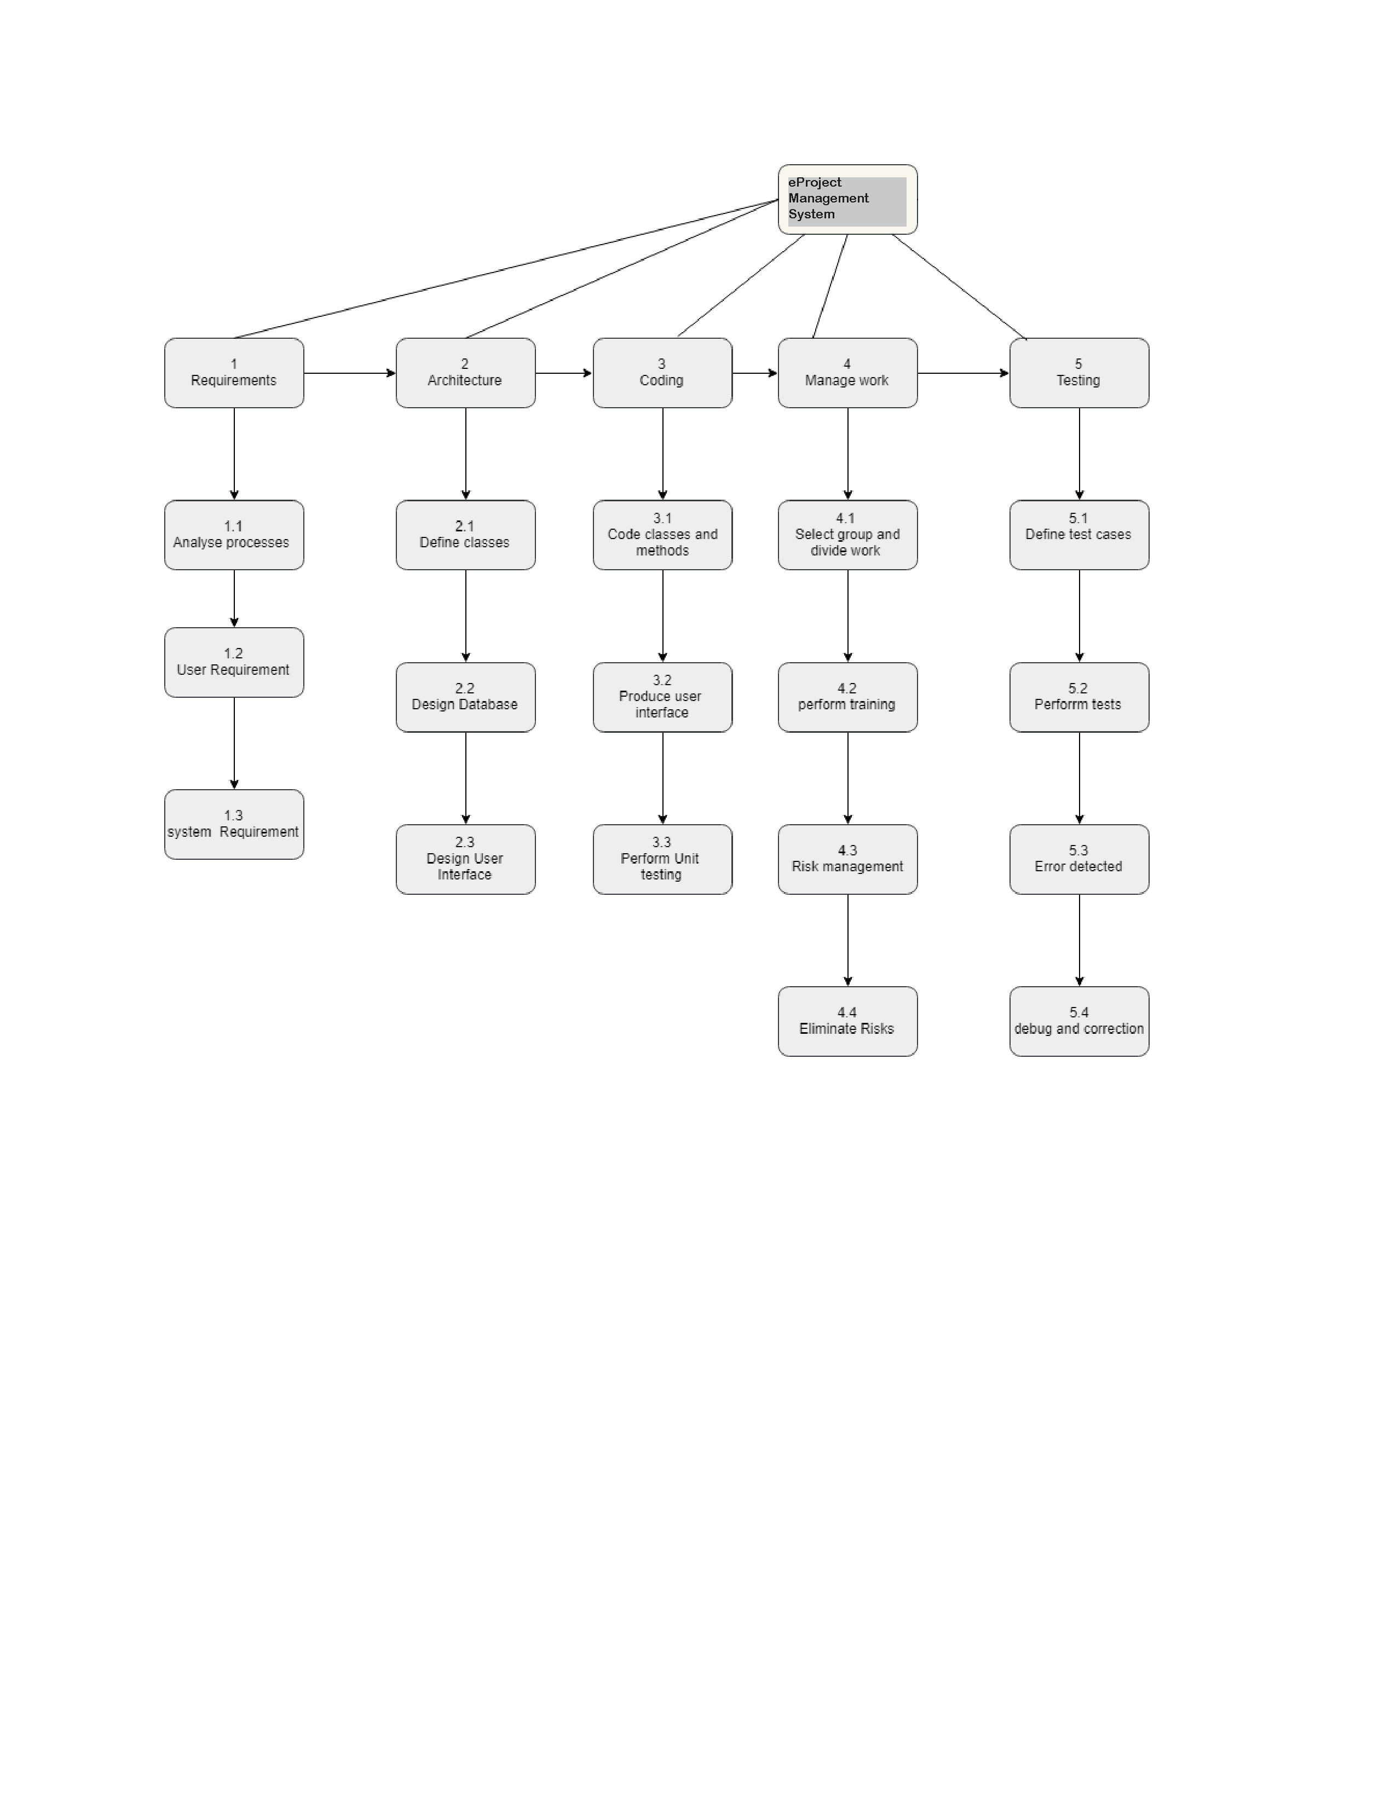
Technicalities
Work breakdown Structure

Slide 24
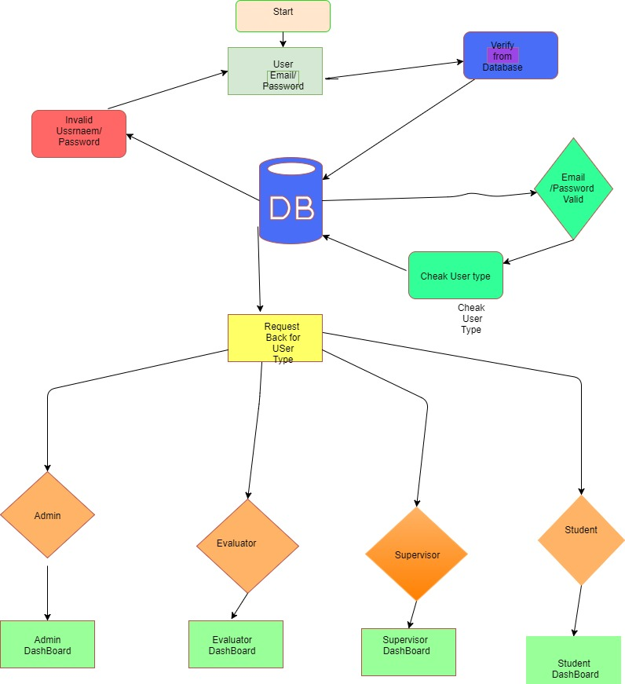
Technicalities
System Architecture

Slide 25
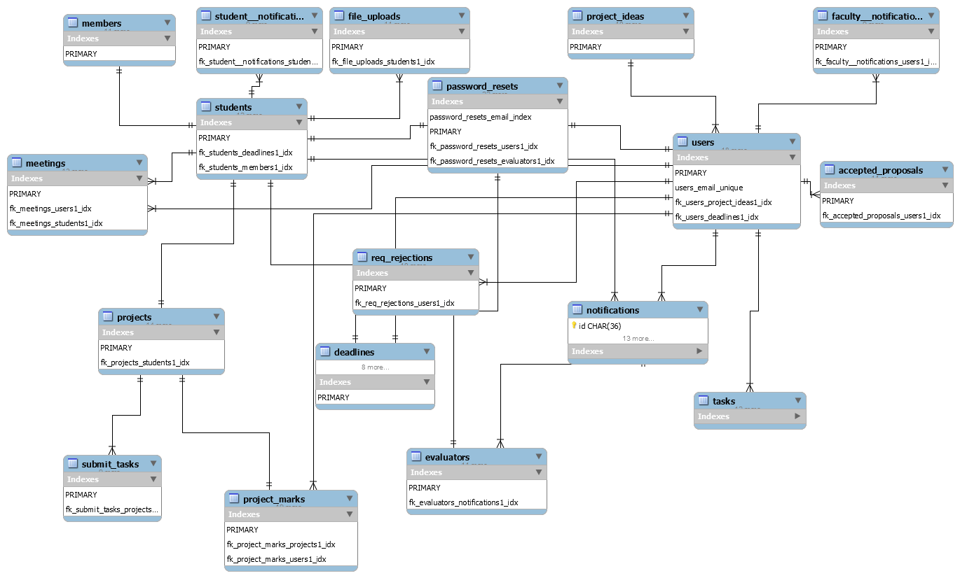
Technicalities
Database Diagram

Slide 26
eProject Management System
Future Work

Slide 27
Future Work
The successful implementation of the system and complete testing will lead towards commercializing this product.
This system can be used for the project management in public, private organisations.

Slide 28
Future Work
An online chat system for communication between supervisor and students.
An android and ios application of this system.

Slide 29


